Slide 1
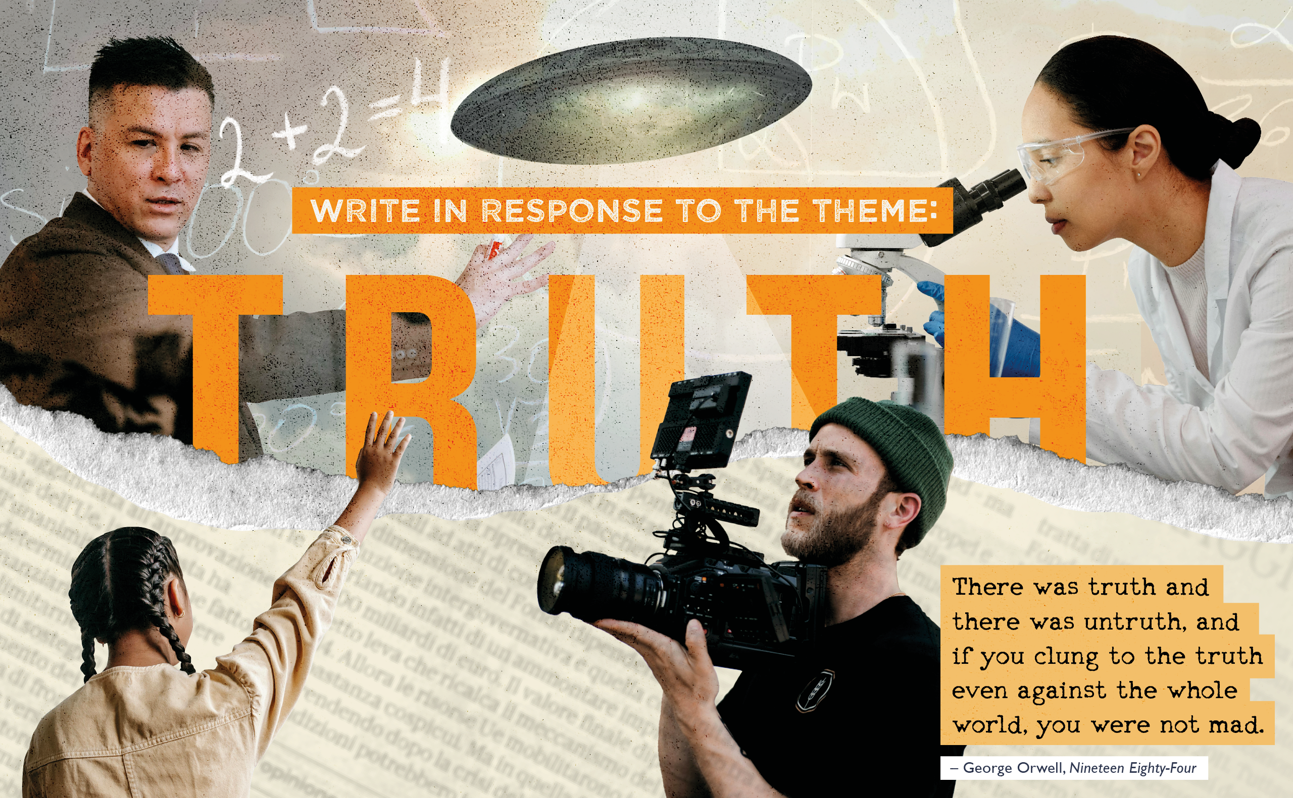

Slide 2

Who was George Orwell?
The Orwell Youth Prize takes its inspiration from the author, journalist and essayist George Orwell
1984? Animal Farm? Phrases like ‘Thought Police’, ‘Big Brother’ and ‘Doublethink’? That’s all him!
Orwell wrote from his own experiences and observed the social injustices and political happenings of the world around him.
He also wrote in language that was clear, concise and compelling.
Orwell’s values
Orwell thought and wrote about the importance of objective truth in his fiction, non-fiction and journalism – he talked about everything from self-censorship, to the truths governments might hide from their people.
We encourage you to follow George Orwell’s example: to write about something that matters to you, and that you want to draw to the attention of others.

Slide 3

What is the Orwell Youth Prize?
The Orwell Youth Prize is a writing Prize for anyone in school years 7-13 (or equivalent).
Every year, we set a theme inspired by the writing of George Orwell (more on him later!). We use this as a starting point to get you thinking about the world around you and issues which matter today.
This year’s theme is ‘Truth.’
You can write in any form – send us your poems, stories, essays, articles, scripts and even video game design concepts (more info and resources on our website).
We’re looking for exciting ideas and great writing – and we can help you make your writing the best it can be!

Slide 4
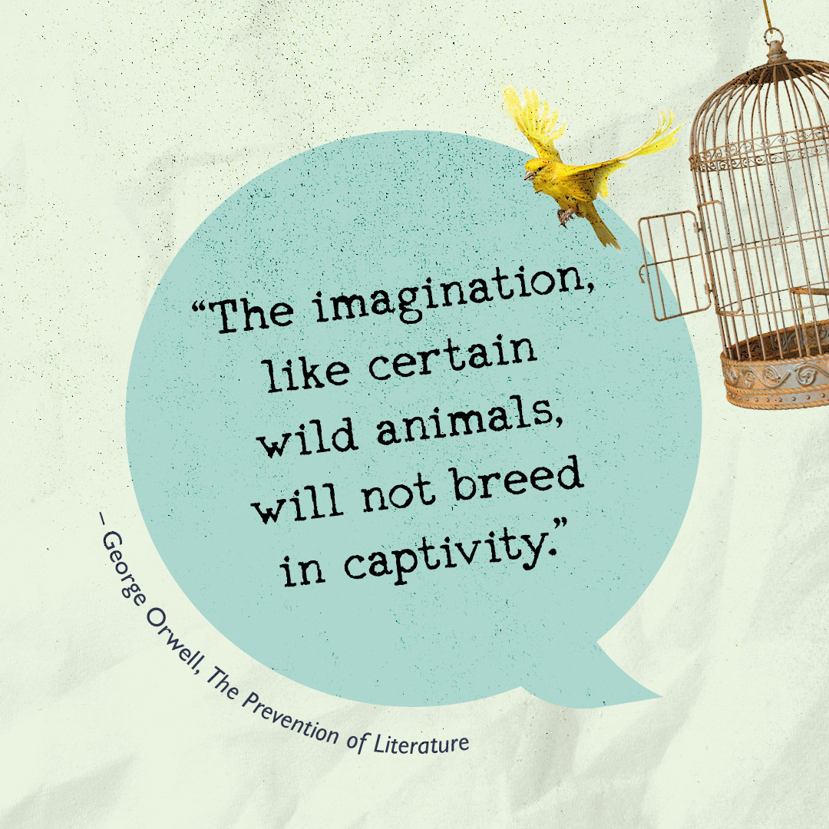
Truth
“There was truth and there was untruth, and if you clung to the truth even against the whole world, you were not mad.” – George Orwell, Nineteen Eighty-Four
We want to hear from YOU!
What does truth mean to you?
What happens to society when we can no longer agree on what is true?
What threats are there to truth, in this country and around the world?
What can be done to protect objective truth?

Slide 5
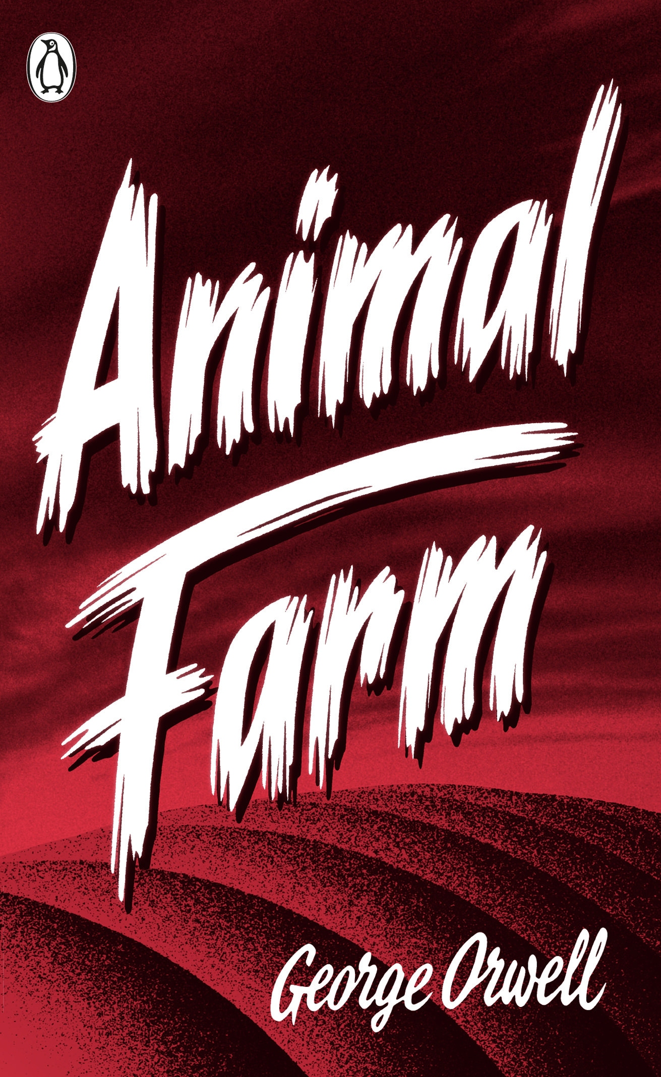
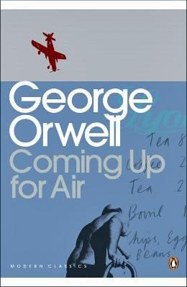
What Could I Win?
A cash prize of £100
Publication on the Orwell Foundation website
Orwell books for you and for your school
An invitation to join the Orwell Youth Fellows
Programme where you will:
- Work on exciting new projects with other young writers
- Get priority access to Orwell Foundation events
- Help shape the future of the Orwell Youth Prize
We will work with you to make sure your writing reaches the people you want to hear your ideas – past winners have received responses from Malorie Blackman, Charlie Brooker, Manveen Rana, Ali Smith, Jess Phillips MP and the Mayor of Bristol!
And it’s not
just about
the winners…

Slide 6
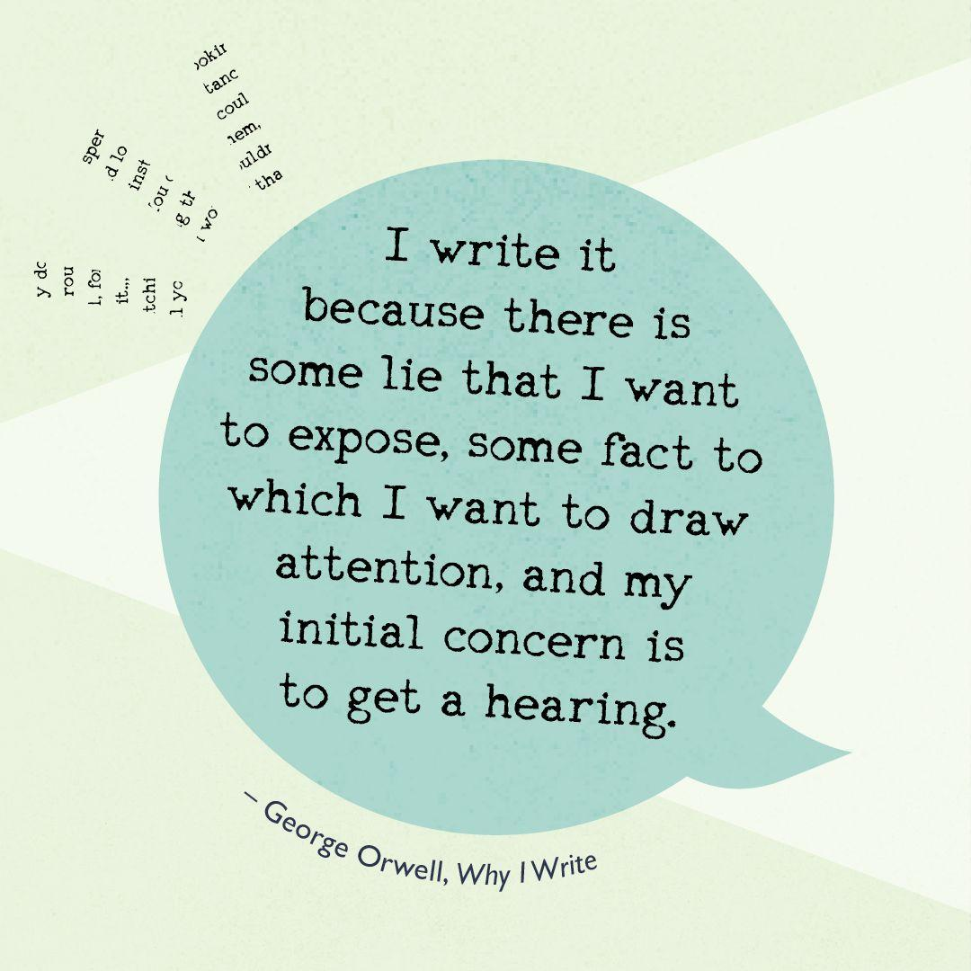
Why Should I Enter?
Far more than just a Prize, we support every entrant to help make their writing the best it can be.
All entries are offered personalised feedback on a first draft.
Our readers work in publishing, academia and the arts, including as professional writers.
You can use this feedback to help develop your piece before you submit your final draft.
Every entry counts – we also look at the collective concerns explored by all our entrants. We’ll aim to give these a platform and share your concerns with politicians and policy makers.

Slide 7
Head to www.orwellyouthprize.co.uk to find out more and to enter.
Follow us on Instagram @orwellyouthprize and X @orwellyouthprize
FEEDBACK DEADLINE: Wednesday 25rd February
FINAL DEADLINE: Wednesday 29th April

