Slide 1
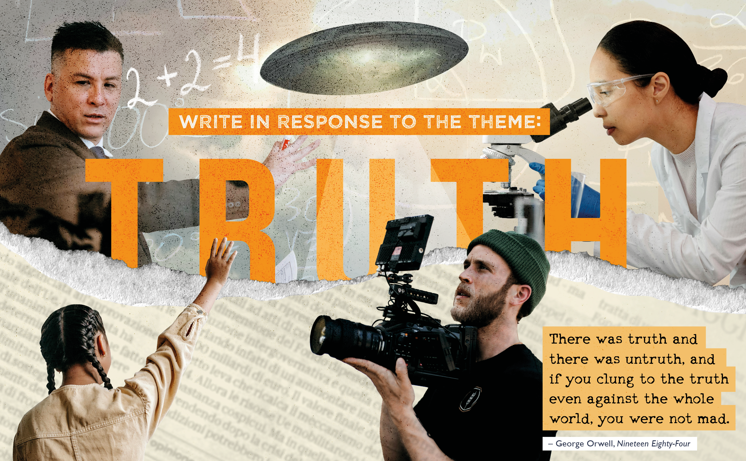
Truth

Slide 2

What is truth?
“Being in agreement with fact or reality”
“The state of being the case”
“An established or verified fact”
What is the opposite of truth?
Untruth: a false statement
Lie: an intentionally false statement.
Notes:
The idea of this slide is to introduce truth as a concept to student. Everyone has some idea of what truth entails, so it is important to get students thinking along the same lines.
These definitions come from the Oxford and Merriam-Webster Dictionaries, and are established definitions of truth in a British and US context.
Ask them to list things which are ‘true’. Then ask why those things are considered to be true.
It may be worth asking them to pick out the words used here ie established, verified, fact, to ground the idea that truths are often objective or, at least, well-researched and supported by a reasoned argument.
Using these, we would suggest coming to a shared definition for the class/as a class.
What about lies? Is there really a difference between lying and telling untruths? Where do they draw the line?

Slide 3
Starting small on a big theme
What is something that you thought was true but don’t anymore?
What evidence made you change your mind?
Is that evidence reliable? (Think about where you got it from, who said it, do they have a good reputation for honesty?)
Notes:
This slide can be used to introduce the idea that truth is contested and can be personal but should nevertheless be rooted in fact.
We also introduce the idea that truth can be difficult to find. It must be arrived at through some kind of effort and research – we want entries to be well-researched, so it is an important point of repetition!
You could encourage both personal examples (e.g. childhood beliefs, myths, sayings) and societal examples (e.g. historical or scientific ideas that were later corrected).
Remind students: it’s fine if the example is light-hearted or serious. The important thing here would be getting them to reason why they thought the thing was true and the process by which they realised that it was false.
It is also important to highlight how new evidence or learning can change our understanding of what is true.
Link to the Orwell Youth Prize: writers and thinkers often challenge accepted “truths”, they may well want to orientate their writing around challenging something that has become taken as true, but isn’t.

Slide 4
Orwell’s desire for ‘Truth.’
In Animal Farm, the ruling pigs distort the truth to stay in power, mirroring the propaganda told by totalitarian regimes during Orwell’s own time – Stalin’s USSR and Hitler’s Germany
In 1984, Winston works at the Ministry of Truth which, “…concerns itself with lies…” and falsifies historical records. Government decides what the ‘truth’ is.
In his social commentary, Down and Out.. And Road to Wigan Pier, Orwell seeks to report on the conditions of ordinary people living in London, Paris, and Wigan – this was because they were never reported on
Notes:
Some students may be familiar with Orwell’s work. It really is at the centre of what we do, and he has lots to say on truth.
His novels (1984, Animal Farm) show how those in power can distort truth to control a community/society.
Do students know what totalitarianism means? Totalitarianism is form of government that theoretically permits no individual freedom and that seeks to subordinate all aspects of individual life to the authority of the state. What do they think would happen to truth in those circumstances?
The final point asks what we need to do to find the truth – Orwell took it upon himself to see Paris, Wigan, London etc and report back to the nation what he saw. This was to raise awareness and to inform the public, who may have been misinformed or simply had not known the extent of poverty.
In essays like Politics and the English Language, he argued that plain writing helps expose lies, the resource is available via this link: https://www.orwellfoundation.com/the-orwell-foundation/orwell/essays-and-other-works/politics-and-the-english-language/
George Orwell believed clear, honest language was essential to finding and sharing truth.
He warned that political spin and vague language can hide facts and mislead people.
For Orwell, telling the truth was a moral duty where writers should help people see reality as it is.
You could also ask: “Why do you think Orwell linked clear language with truth?” or “Can you think of modern examples where language is used to hide or twist facts?”

Slide 5
Orwell and finding truth
Orwell thought it important that truth, even when inconvenient or unpopular, must be defended.
He also warned that “The very concept of objective truth is fading out of the world. Lies will pass into history.”
What is the significance of this quote?
What can an individual do?
How can we know something is true?
Orwell encourages us to ask who isn’t telling the truth, and why that might be.
Notes:
Start by asking them to break down Orwell’s warning and answering the questions. Discuss.
Relate back to the previous slide and totalitarianism. Orwell was on the political left and fought in the Spanish Civil War against fascism. However, he found himself criticising those who supported Stalin’s USSR. He did so because the truth was being distorted by the totalitarian government, and its supporters or wartime allies in the U.K. Orwell had lengthy discussions about censorship at various points, including this piece where he questions the British government and the impact of Soviet propaganda: https://www.orwellfoundation.com/the-orwell-foundation/orwell/essays-and-other-works/the-freedom-of-the-press/
If time permits, it is worth thinking about why his writing of Animal Farm would be considered unpopular or inconvenient in 1942?
Some other things for students to consider, which may be familiar for some studying the History curriculum:
Check evidence and sources before sharing information.
Challenge misinformation respectfully.
Value honesty in your own writing and conversations.
Look for multiple reliable sources.
Ask if there is credible evidence or expert consensus.

Slide 6
Who might not be telling the truth and why?
Think both personally and more widely. It might help to ask why people lie.
Make a list of people/institutions that aren’t telling the truth
Give a reason justifying why you think they are lying (what evidence is there?)
Give a reason for why they might lie? How do they benefit?
Is it possible to lie by accident?
Notes:
The idea behind this slide is to get young people thinking about why people/institutions may not tell the truth – it may be worth asking why this happens in different contexts, is it for political support? For views? Etc, it is important to understand the reasoning behind the distortion of truth. One simple framing may be, who benefits if this lie is accepted?
Examples to get them started:
Governments or politicians (to gain votes or maintain power)
Companies or advertisers (to sell products)
Media outlets or social media posts (to attract attention or clicks)
Historical sources or propaganda (to influence opinion or rewrite history)
Encourage students to suggest evidence for their examples—news reports, fact-checking sites, books, public records etc. It may help to consider what makes for a reliable source.

Slide 7
Writing about truth
What truth do you want the reader to be aware of?
Is this truth hidden from them?
Why is it important to you?
Your personal view is important, we want to hear your voice come through in any form you choose
However, your voice will always come across stronger if your writing is supported by the facts!
Notes:
We regularly receive submissions as short stories, essays, poems, graphic novels, scripts, game designs, and more, so encourage expression through whatever medium they feel most confident with. We want to see them express themselves.
Similarly, it is worth relating this to the following judging criteria:
When you are writing, you should consider:
Political purpose: Give your writing a clear message or aim. Make people think about how the world could be better, highlight a problem, or encourage them to see society in a new way. Write about things you notice around you - your town, your street, or everyday life.
Clarity of expression: Make your ideas easy to understand. Good writing is clear and lets the reader see your thoughts without being distracted by complicated words. Avoid jargon and abstract nouns - use concrete, everyday language.
Brave and independent thinking: Be honest about what you really believe and what you’ve experienced. Think for yourself and question ideas, even if they are popular. Base what you write on evidence and be clear when you are giving your own opinion.
Open and informed thinking: Check your own views. Consider how others might feel and make sure your opinion is based on good information - not just your own bubble.
Artful writing: Use language in a way that sounds and feels good to read. Enjoy the rhythm of your words and share something you think is worth experiencing.
Alignment to the theme: Show how your writing explores the theme. Try to be original and clear. Think about what you have read - great writers are great readers - so draw on books, stories, or articles that inspire you.

Slide 8
Let’s get writing!
Tips and help can be found on our website.
We have resources to support each form of writing: https://www.orwellfoundation.com/the-orwell-youth-prize/for-young-writers/find-your-form/
We also have a free collection of Orwell essays and writing here: https://www.orwellfoundation.com/the-orwell-foundation/orwell/essays-and-other-works/

Slide 9
Head to www.orwellyouthprize.co.uk to find out more and to enter.
Follow us on Instagram @orwellyouthprize and X @orwellyouthprize
FEEDBACK DEADLINE: Wednesday 25th February
FINAL DEADLINE: Wednesday 29th April

