Slide 1

WRITE IN RESPONSE TO THE THEME:
ACTS OF
COURAGE
“Freedom of the intellect means the freedom to report what one has seen, heard, and felt, and not to be obliged to fabricate imaginary facts and feelings.”
— George Orwell, The Prevention of Literature

Slide 2
Who was George Orwell?
The Orwell Youth Prize takes its inspiration from the author, journalist and essayist George Orwell
1984? Animal Farm? Phrases like ‘Thought Police’, ‘Big Brother’ and ‘Doublethink’? That’s all him!
Orwell’s values
Orwell thought and wrote about the importance of facing up to fear and telling the truth about it and he explored everything from ordinary people’s courage to his own moments of cowardice.
We encourage you to follow George Orwell’s example: to write about something that matters to you, and that you want to draw to the attention of others, even when it takes courage to say it.

Slide 3

What is the Orwell Youth Prize?
The Orwell Youth Prize is a writing Prize for anyone in school years 7-13 (or equivalent).
Every year, we set a theme inspired by the writing of George Orwell. We use this as a starting point to get you thinking about the world around you and issues which matter today.
This year’s theme is ‘Acts of Courage’
You can write in any form – send us your poems, stories, essays, articles, scripts and even video game design concepts (more info and resources on our website).
We’re looking for exciting ideas and great writing – and we can help you make your writing the best it can be!

Slide 4
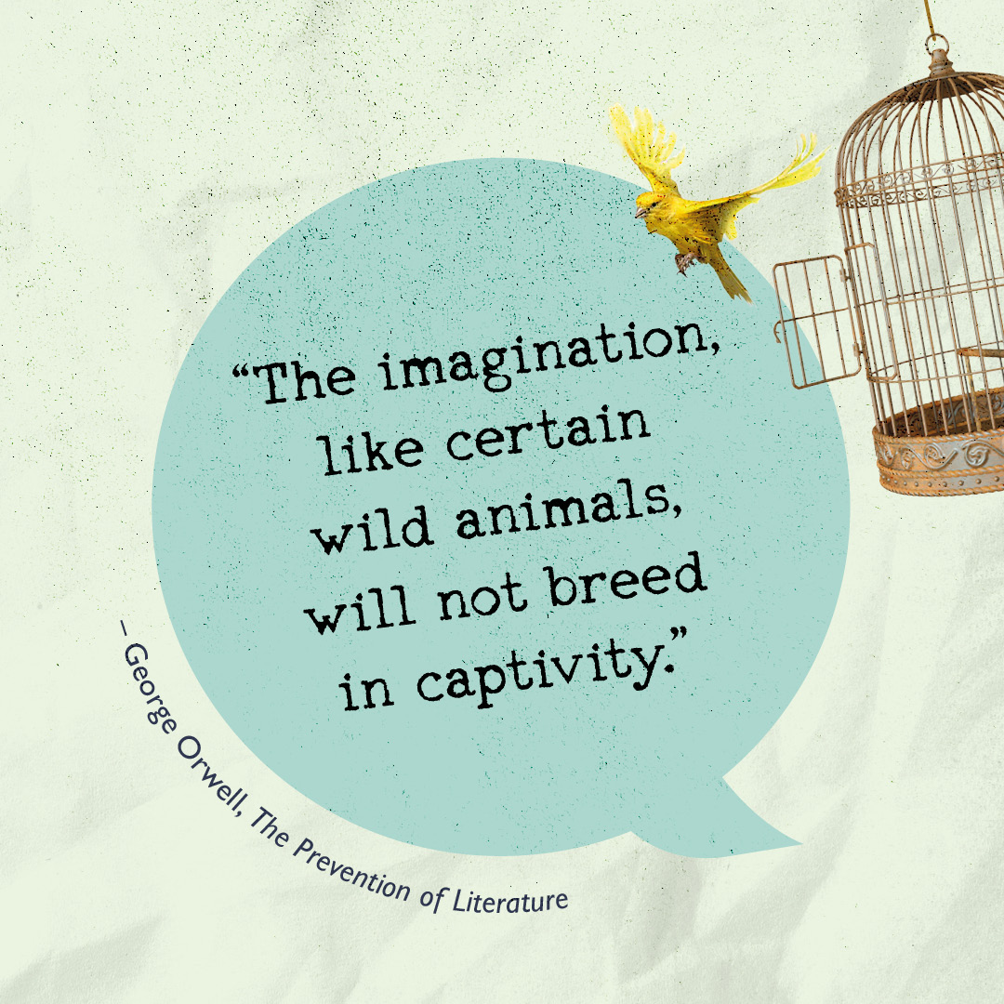
Acts of Courage
“There are occasions when it pays better to fight and be beaten than not to fight at all.” – George Orwell, Homage to Catalonia
We want to hear from YOU!
What does courage mean to you?
What stops us from doing the brave thing, even when we want to?
Do any kinds of courage go unnoticed or unrewarded?
What could you do, in your own life, to act a little more courageously?

Slide 5
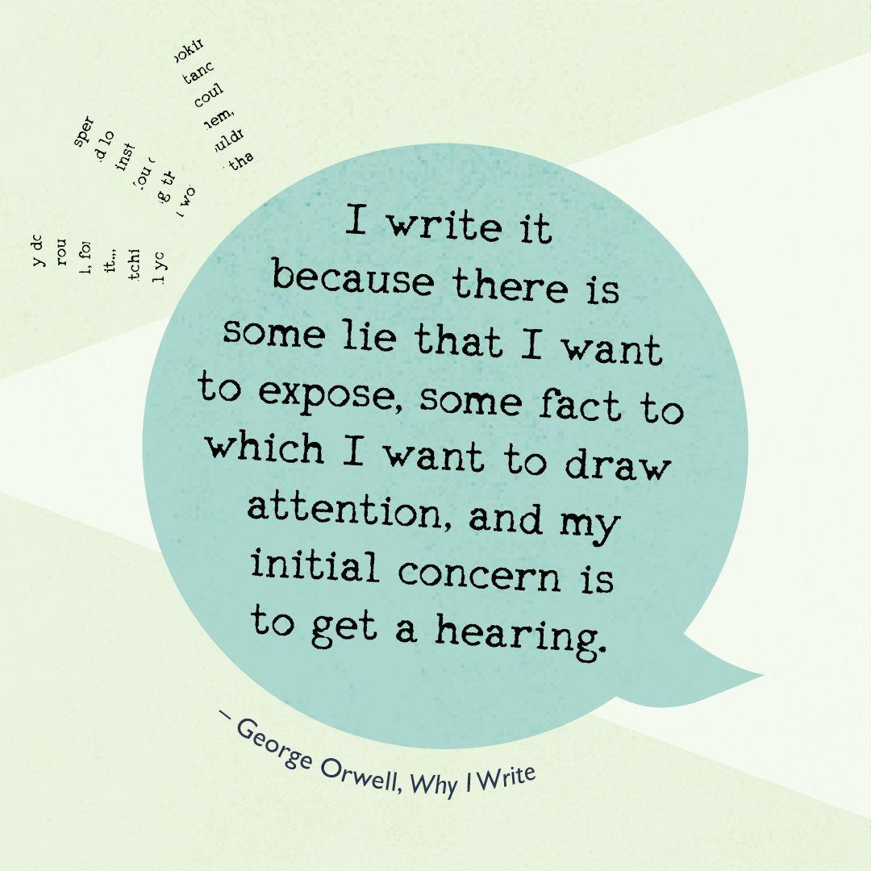
Why Should I Enter?
Far more than just a Prize, we support every entrant to help make their writing the best it can be.
All entries are offered personalised feedback on a first draft.
Our readers work in publishing, academia and the arts, including as professional writers.
You can use this feedback to help develop your piece before you submit your final draft.
Every entry counts – we also look at the collective concerns explored by all our entrants. We’ll aim to give these a platform and share your concerns with politicians and policy makers.

Slide 6


What Could I Win?
A cash prize of £100
Publication on the Orwell Foundation website
Orwell books for you and for your school
An invitation to join the Orwell Youth Fellows
Programme where you will:
- Work on exciting new projects with other young writers
- Get priority access to Orwell Foundation events
- Help shape the future of the Orwell Youth Prize
We will work with you to make sure your writing reaches the people you want to hear your ideas – past winners have received responses from Malorie Blackman, Charlie Brooker, Manveen Rana, Ali Smith, Jess Phillips MP and the Mayor of Bristol!
And it’s not
just about
the winners…

Slide 7
WRITE IN RESPONSE TO THE THEME:
ACTS OF
COURAGE
Head to www.orwellyouthprize.co.uk to find out more and to enter.
Follow us on Instagram @orwellyouthprize and X @orwellyouthprize
FEEDBACK DEADLINE: Wednesday 3rd March 2027
FINAL DEADLINE: Wednesday 28th April 2027
“Freedom of the intellect means the freedom to report what one has seen, heard, and felt, and not to be obliged to fabricate imaginary facts and feelings.”
— George Orwell, The Prevention of Literature

